Slide 1

Algebra 1
Unit 1, Lesson 1 Classifying Parent Functions Volume 1, pg. 3

Slide 2


Benchmark
MA.912.F.1.1
Given an equation or graph that defines a function, classify the function type. Given an input-output table, determine a function type that could represent it.
volume 1, pg. 3

Slide 3
Integrated Mathematical Thinking and Reasoning Standards
MA.K12.MTR.1.1 Actively participate in effortful learning both individually and collectively.
MA.K12.MTR.2.1 Demonstrate understanding by representing problems in multiple ways.
MA.K12.MTR.5.1 Use patterns and structure to help understand and connect mathematical concepts.
volume 1, pg. 3

Slide 4

Learning Target
I can classify families of functions from a graph or equation.
volume 1, pg. 3

Slide 5

Warm-Up
volume 1, pg. 3

Slide 6
1.1.1 Warm-Up: Would You Rather?
Complete the chart by moving around the room and asking nine different people “Would you rather ...?” Introduce yourself to each person. Ask each person a different question from your chart. Record their name and their answer.
Would you rather ...
fly a kite or swing on a swing? | be a famous inventor or a famous writer? | go skiing or go to a water park?
volume 1, pg. 3
Notes:
Video Link: https://algebranation.wistia.com/medias/fi4fidi5y8

Slide 7
Would you rather ...
be able to create a new holiday or create a new sport? | start a colony on another planet or be the leader of a small country on Earth? | own an old pirate ship with crew or a private jet with a pilot?
see a firework display or a circus performance? | be able to talk to land animals or talk to sea animals? | time-travel to the past or the future?
volume 1, pg. 3

Slide 8

Activity
volume 1, pg. 4

Slide 9

1.1.2 Activity: Parent Functions Gallery Walk
The study of functions is an area of focus in algebra. Functions are classified into families. The parent function is the simplest function of each family that preserves the characteristics of the family.
Here are eight parent functions that will be introduced in Algebra 1. After you examine each parent function, answer the questions that follow.
volume 1, pg. 4

Slide 10
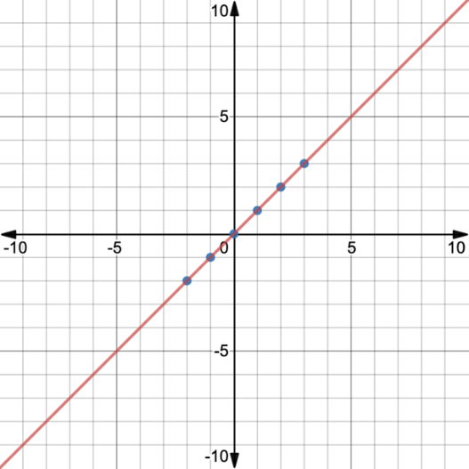
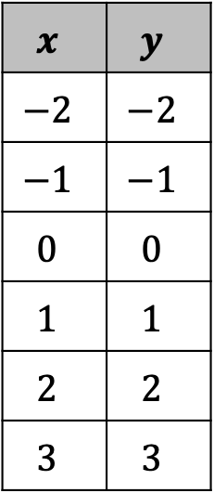
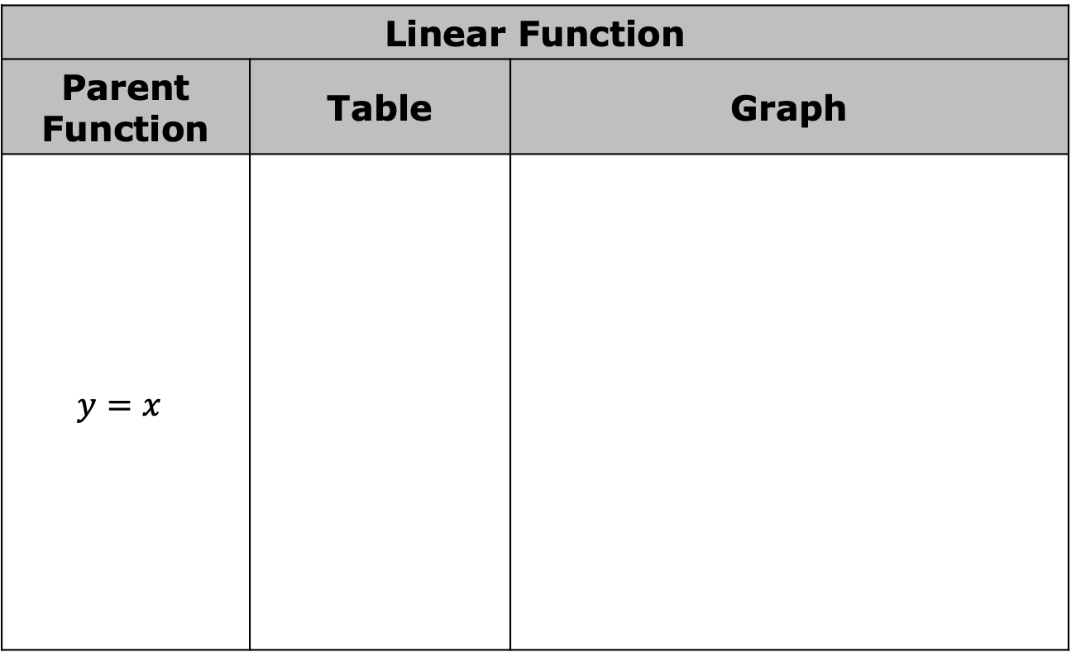
Linear Function
Parent Function | Table | Graph
$$y=x$$
$$x$$ | $$y$$
$$−2$$ | $$−2$$
$$−1$$ | $$−1$$
$$0$$ | $$0$$
$$1$$ | $$1$$
$$2$$ | $$2$$
$$3$$ | $$3$$
volume 1, pg. 4

Slide 11
What do you notice about the graph?
What do you notice about the equation?
volume 1, pg. 4

Slide 12
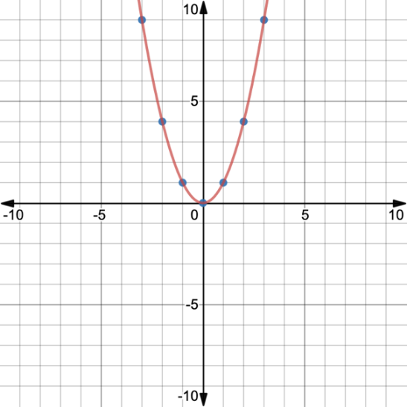

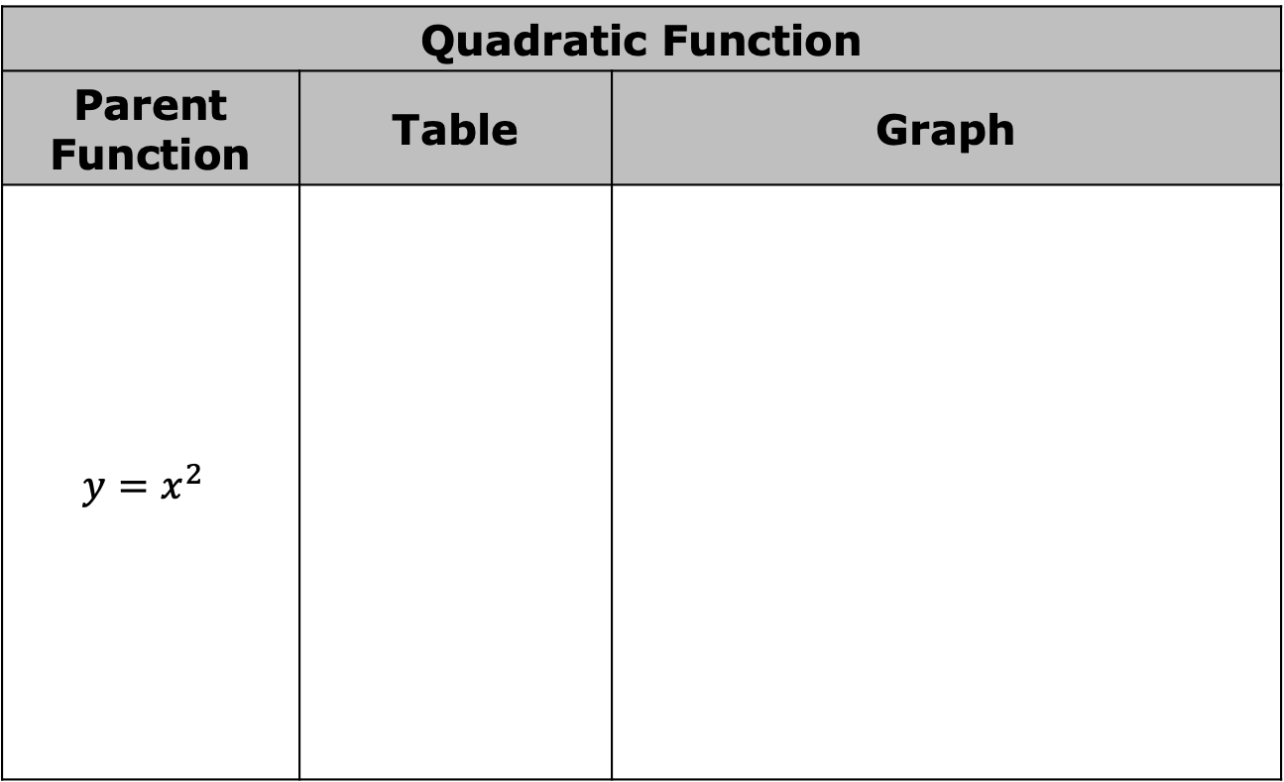
Quadratic Function
Parent Function | Table | Graph
$$y=x^{2}$$
$$x$$ | $$y$$
$$−2$$ | $$4$$
$$−1$$ | $$1$$
$$0$$ | $$0$$
$$1$$ | $$1$$
$$2$$ | $$4$$
$$3$$ | $$9$$
volume 1, pg. 4

Slide 13
What do you notice about the graph?
What do you notice about the equation?
volume 1, pg. 4

Slide 14
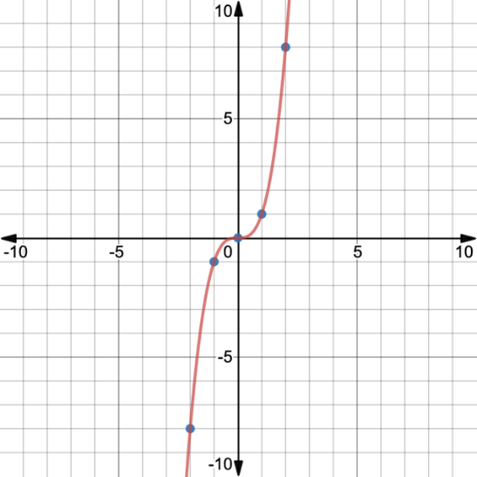
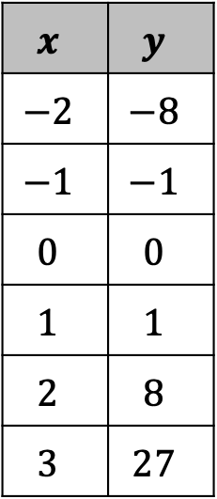
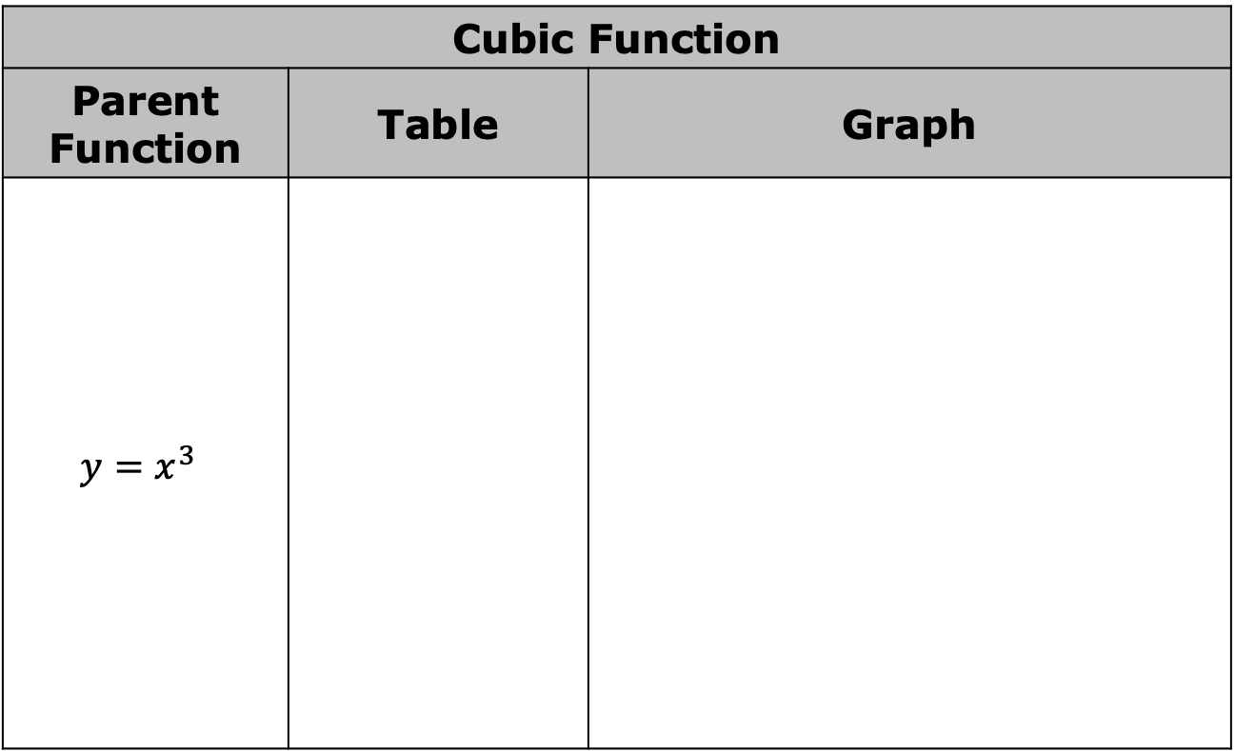
Cubic Function
Parent Function | Table | Graph
$$y=x^{3}$$
$$x$$ | $$y$$
$$−2$$ | $$−8$$
$$−1$$ | $$−1$$
$$0$$ | $$0$$
$$1$$ | $$1$$
$$2$$ | $$8$$
$$3$$ | $$27$$
volume 1, pg. 5

Slide 15
What do you notice about the graph?
What do you notice about the equation?
volume 1, pg. 5

Slide 16
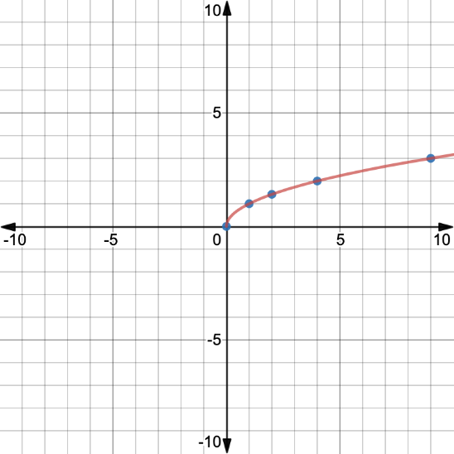
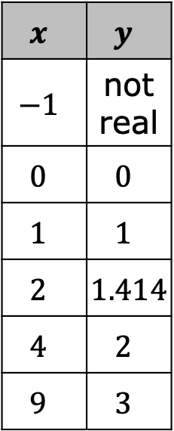
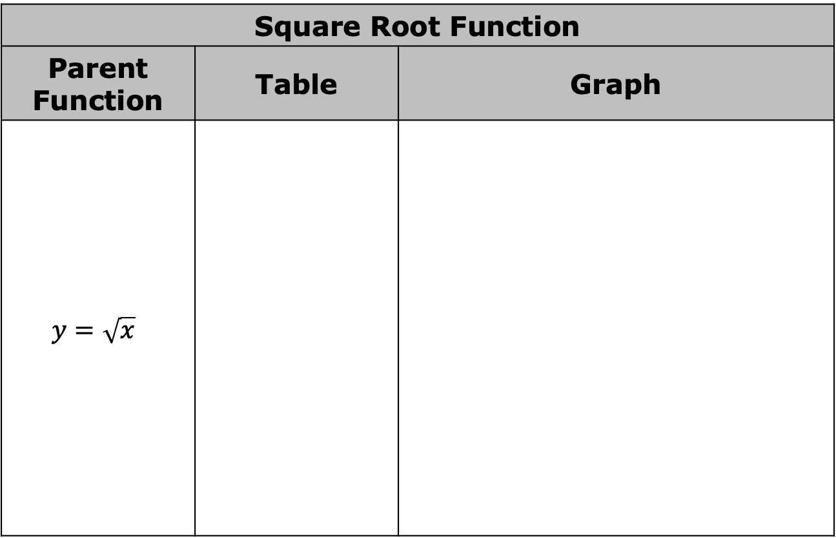
Square Root Function
Parent Function | Table | Graph
$$y=\sqrt{x}$$
$$x$$ | $$y$$
$$−1$$ | not real
$$0$$ | $$0$$
$$1$$ | $$1$$
$$2$$ | $$1.414$$
$$4$$ | $$2$$
$$9$$ | $$3$$
volume 1, pg. 5

Slide 17
What do you notice about the graph?
What do you notice about the equation?
volume 1, pg. 5

Slide 18
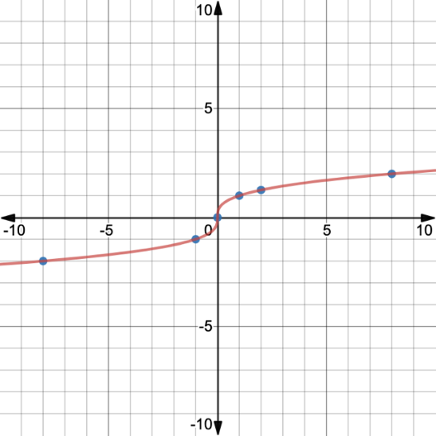
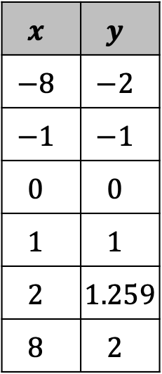

Cube Root Function
Parent Function | Table | Graph
$$y=\sqrt[3]{x}$$
$$x$$ | $$y$$
$$−8$$ | $$−2$$
$$−1$$ | $$−1$$
$$0$$ | $$0$$
$$1$$ | $$1$$
$$2$$ | $$1.259$$
$$8$$ | $$2$$
volume 1, pg. 6

Slide 19
What do you notice about the graph?
What do you notice about the equation?
volume 1, pg. 6

Slide 20
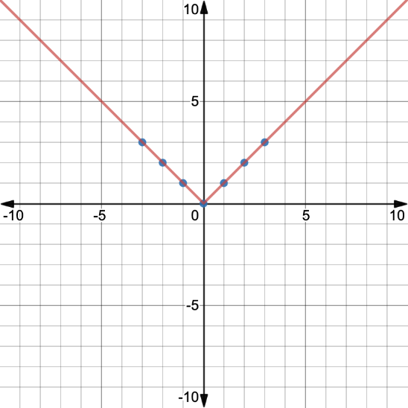

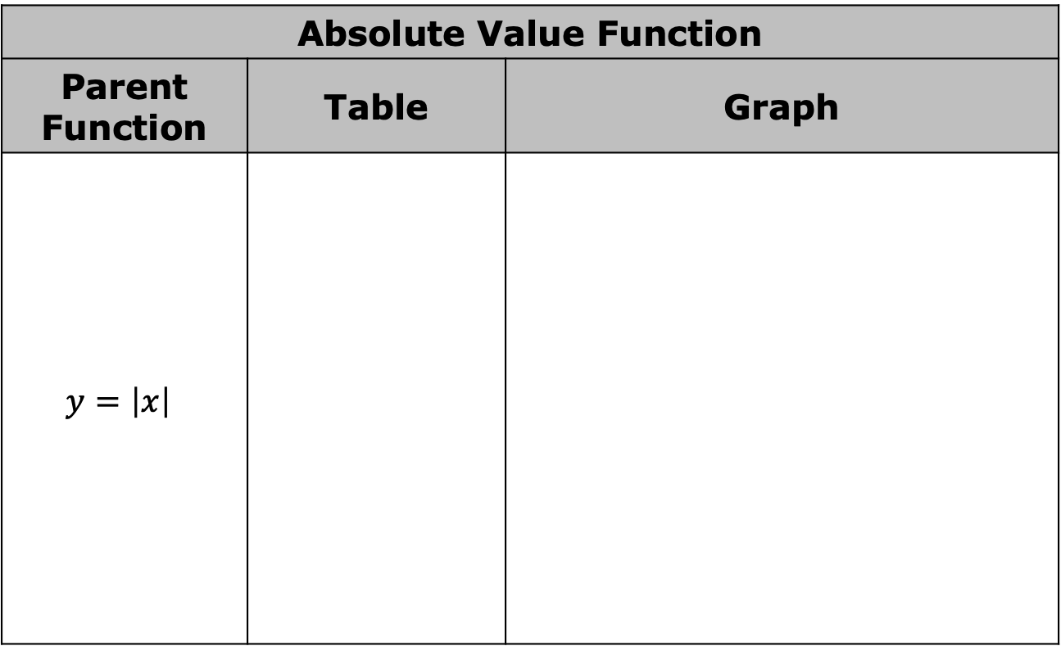
Absolute Value Function
Parent Function | Table | Graph
$$y=\left|x\right|$$
$$x$$ | $$y$$
$$−2$$ | $$2$$
$$−1$$ | $$1$$
$$0$$ | $$0$$
$$1$$ | $$1$$
$$2$$ | $$2$$
$$3$$ | $$3$$
volume 1, pg. 6

Slide 21
What do you notice about the graph?
What do you notice about the equation?
volume 1, pg. 6

Slide 22
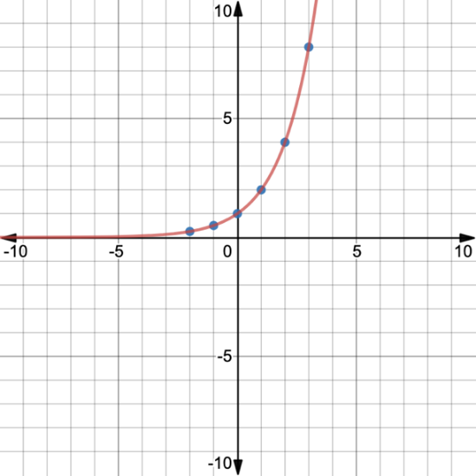
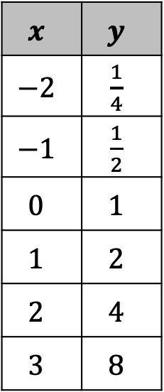
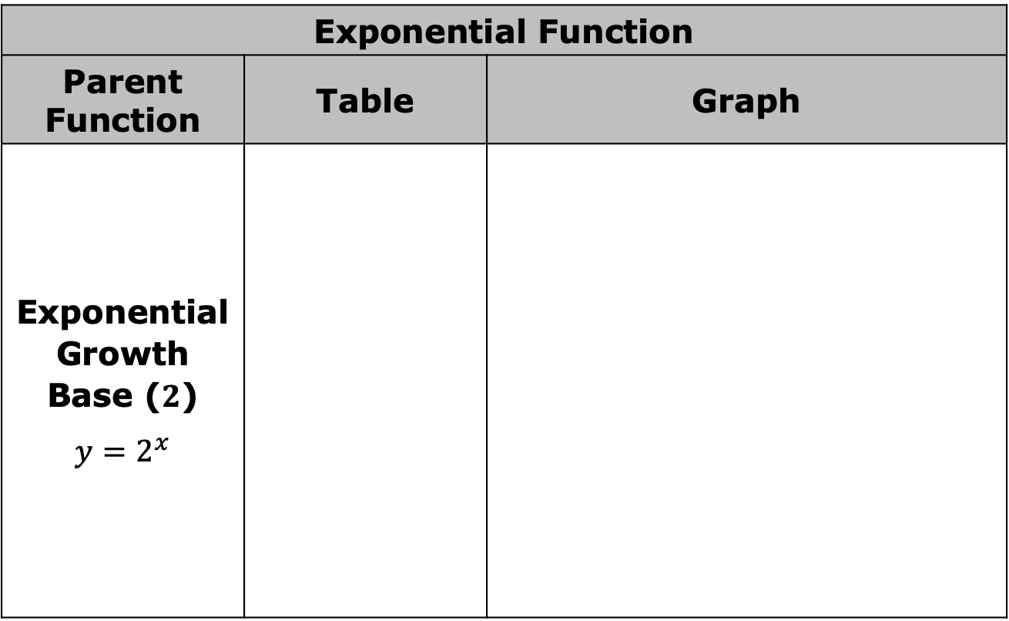
Exponential Function
Parent Function | Table | Graph
Exponential Growth Base ($2$) $$y=2^{x}$$
$$x$$ | $$y$$
$$−2$$ | $\frac{1}{4}$
$$−1$$ | $\frac{1}{2}$
$$0$$ | $$1$$
$$1$$ | $$2$$
$$2$$ | $$4$$
$$3$$ | $$8$$
volume 1, pg. 7

Slide 23
What do you notice about the graph?
What do you notice about the equation?
volume 1, pg. 7

Slide 24
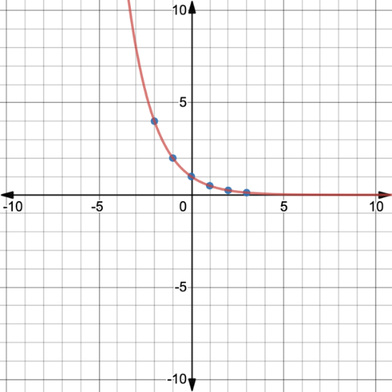
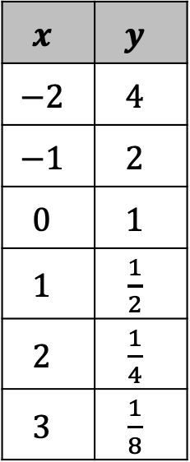
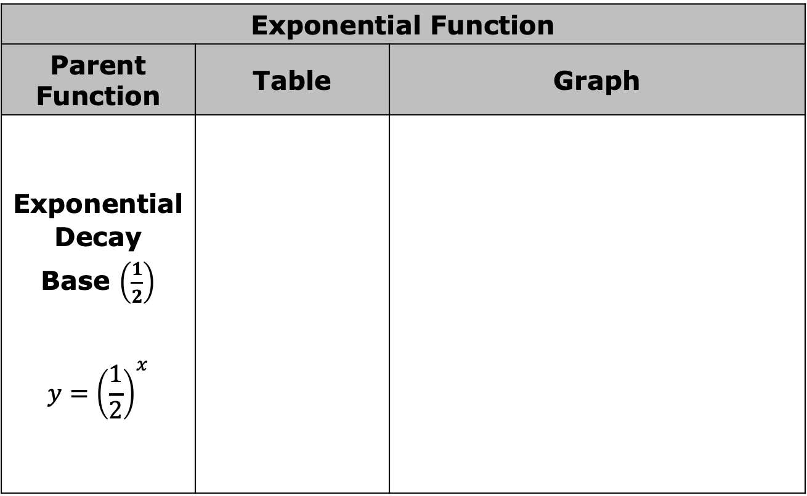
Exponential Function
Parent Function | Table | Graph
Exponential Decay Base $\left(\frac{1}{2}\right)$ $$y={\left(\frac{1}{2}\right)}^{x}$$
$$x$$ | $$y$$
$$−2$$ | $$4$$
$$−1$$ | $$2$$
$$0$$ | $$1$$
$$1$$ | $\frac{1}{2}$
$$2$$ | $\frac{1}{4}$
$$3$$ | $\frac{1}{8}$
volume 1, pg. 7

Slide 25
What do you notice about the graph?
What do you notice about the equation?
volume 1, pg. 7

Slide 26

Guided Practice
volume 1, pg. 8

Slide 27

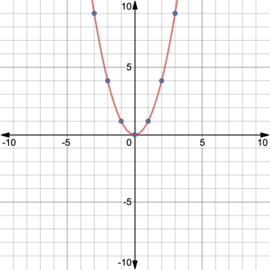
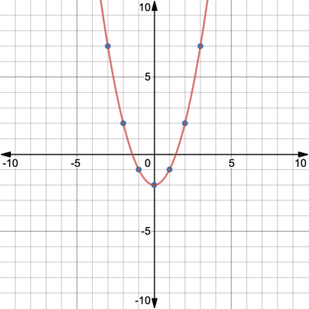
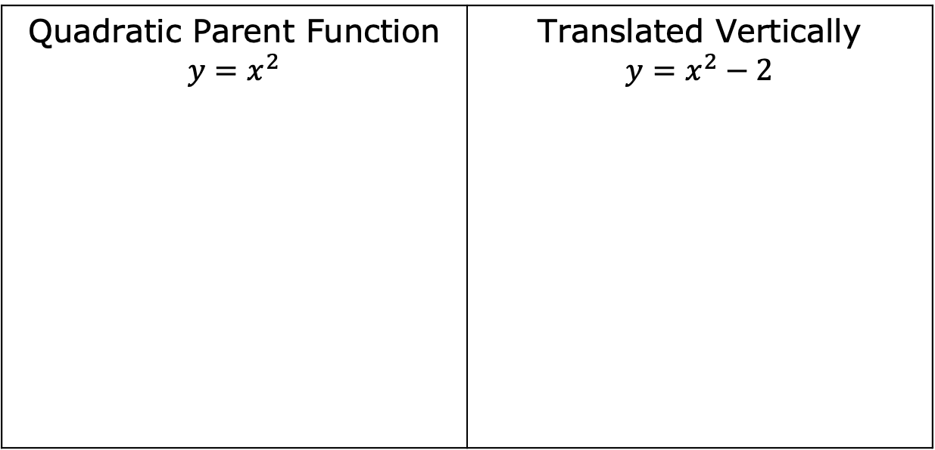
1.1.3 Guided Practice: Classifying Functions
Functions can be transformed by translations, dilations, and reflections.
In this example, the quadratic parent function is translated vertically, horizontally, and reflected over the 𝑥-axis.
Quadratic Parent Function $$y=x^{2}$$ | Translated Vertically $$y=x^{2}−2$$
volume 1, pg. 8

Slide 28
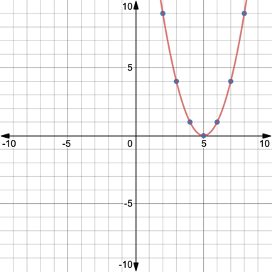
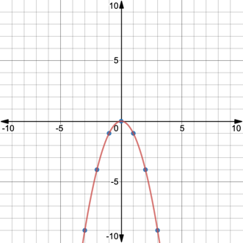
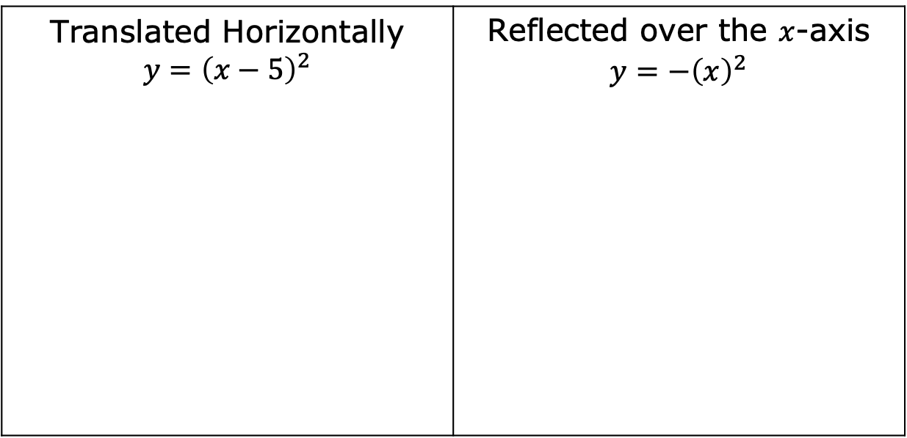
Translated Horizontally $$y={\left(x−5\right)}^{2}$$ | Reflected over the $x$-axis $$y={−\left(x\right)}^{2}$$
volume 1, pg. 8

Slide 29
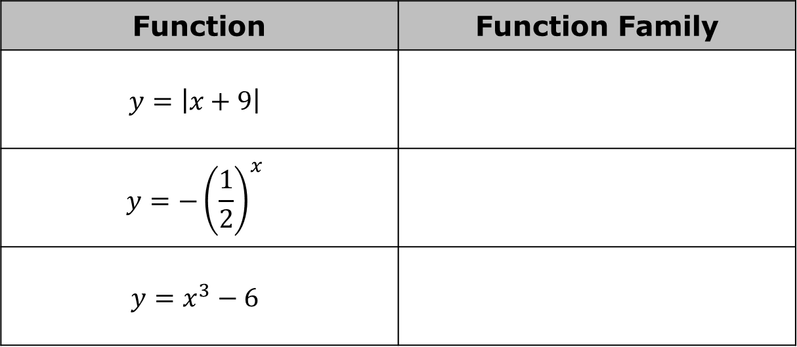
What stayed the same in each of the equations?
What stayed the same in each of the graphs?
Classify each function into its function family based on the characteristics observed for the parent functions.
Function | Function Family
$$y=\left|x+9\right|$$
$$y={−\left(\frac{1}{2}\right)}^{x}$$
$$y=x^{3}−6$$
volume 1, pg. 8

Slide 30
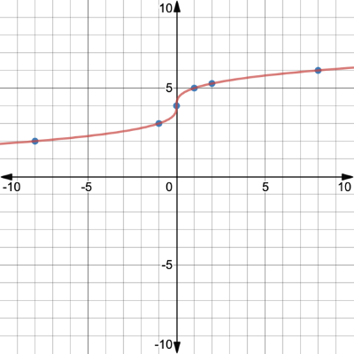
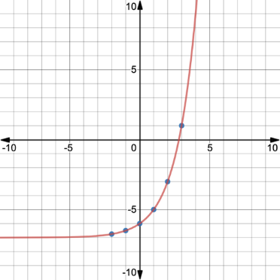
Function | Function Family
volume 1, pg. 8

Slide 31

Your Turn
volume 1, pg. 9

Slide 32

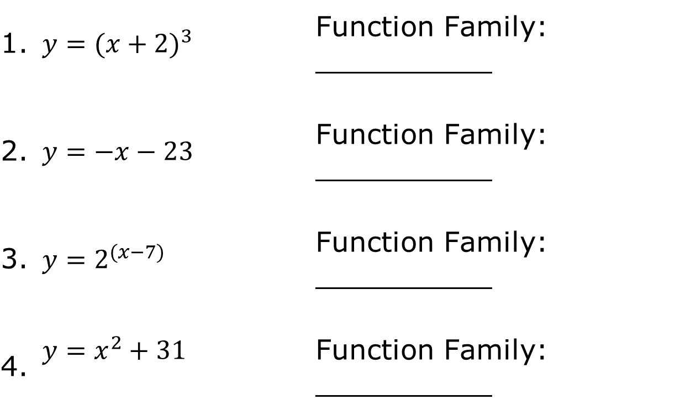
1.1.4 Your Turn!
Classify the function family for each equation or graph.
1. | $$y={(x+2)}^{3}$$ | Function Family: __________
2. | $$y=−x−23$$ | Function Family: __________
3. | $$y=2^{(x−7)}$$ | Function Family: __________
4. | $$y=x^{2}+31$$ | Function Family: __________
volume 1, pg. 9

Slide 33
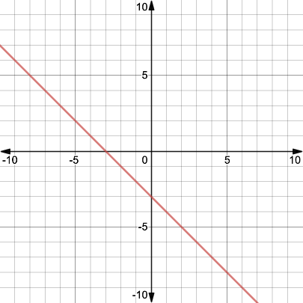
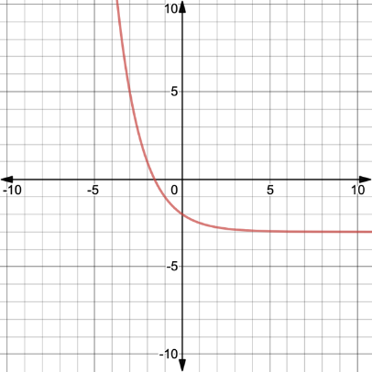
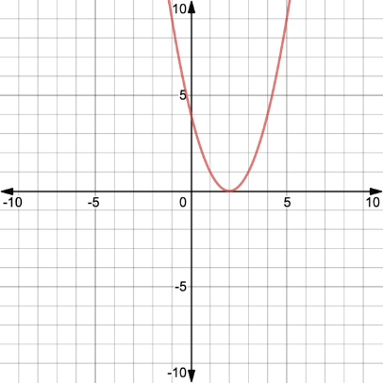
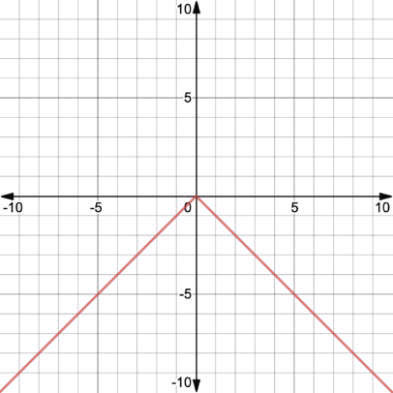
5. Function Family: _______ | 6. Function Family: _______
7. Function Family: _______ | 8. Function Family: _______
volume 1, pg. 9

Slide 34

Wrap-Up
volume 1, pg. 9

Slide 35
1.1.5 Wrap-Up: Reflection
As you begin your journey through Algebra 1, rate yourself on where you feel you are today on the following skills.
Skill | 1 – I am just starting. 2 – I have some skills. 3 – I am almost there. 4 – I have it!
I can evaluate expressions using order of operations.
I can graph points on a coordinate plane.
I can apply the laws of exponents.
I can determine whether a relation is a function.
volume 1, pg. 9

Slide 36
Rate yourself based on how you feel about the following statements.
Statement | 1 – I struggle with this. 2 – I am ready to grow in this area. 3 – I am almost there. 4 – That’s me!
I am willing to try new things.
I persevere when something is challenging.
I am a student learner.
I am a mathematician.
volume 1, pg. 9

